Slide 1


CAT-A-THON
Data Mining Project Using Telematics Data to Predict Engine Failures
Team - Artana
Kaushik S
Harihararam S

Slide 2
Tools used
Python 3.9.x
Libraries used :
Algorithm used :
Polynomial regression for regression analysis (Prediction)
Pandas
NumPy
Sklearn
matplotlib

Slide 3
Process flow
Data pre-processing and Data Extraction
Exploratory data analysis is performed & required data is extracted using Pandas
Data visualization and Model building & training
The data is visualized using matplotlib and the model is built and is trained using the data with sklearn.
The model is visualized and the value is predicted using Polynomial regression
Value prediction
Notes:
Data pre-processing→1st Exploratory cleaned data and removed redundant data

Slide 4
Explanation and Suggestions
How the algorithm works?
Identifies a suitable N^{th} degree polynomial which relates between the dependent and independent variables and uses this to predict values.
Independent variable – “date” field
Dependent variable – “weighted units” field
Weighted units is the product of unit and no of occurrence field.
This regression approximates the polynomial function which assists us in finding the date before engine failure.
Suggestions :
Model can predict the dates remaining to replace the candidate before the engine failure.
The model will provide you the date before the failure threshold.
The suggestions are based upon severity levels.(1, 2 and 3).
Severity level | Criticality of replacement
1 | Highly critical level
2 | Moderately critical level
3 | Minor
Notes:
Here we use a degree 4 polynomial for approximation (best R^2 value)

Slide 5
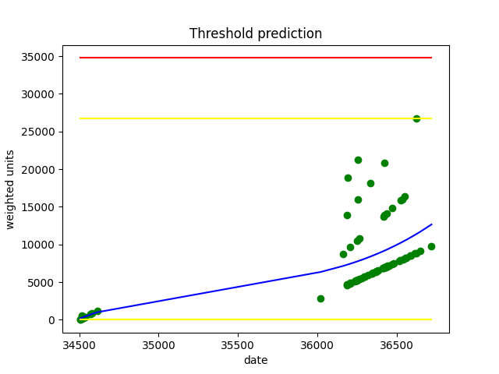
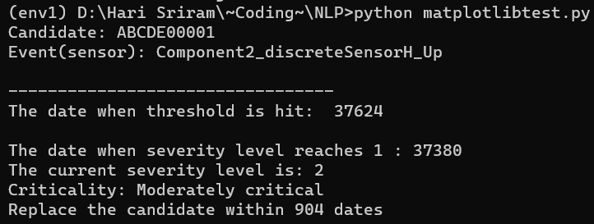
Visualized polynomial
Key
Predicted polynomial
Original values used for training
Severity levels
Threshold level
Code output
Notes:
This was the output of our project. In our project we worked on a single sensor of a particular candidate and we predicted when the candidate’s units will reach the entire engine failure.

Slide 6
Thank you!
Resources (Project code)
Google Colab link – [Click here]
Regards, Team - Artana
-Kaushik S
-Harihararam S

